Slide 1
C2P India
QA Track

Slide 2
Introduction and Agenda
QA Process Checklist
Reading and understanding Requirements
MCQ

Slide 3
TC Drafting Checklist
A Standard set of Test Case Drafting Checklist has been framed to be followed across Projects/Products in C2P
The snapshots below are from standard checklist that should be used for Project/Product.
The Checklist will help in maintaining the synchronization between different Projects/Products
The Checklist will also help in Resource grabbing the basic things faster in case of Project switch.

Slide 4
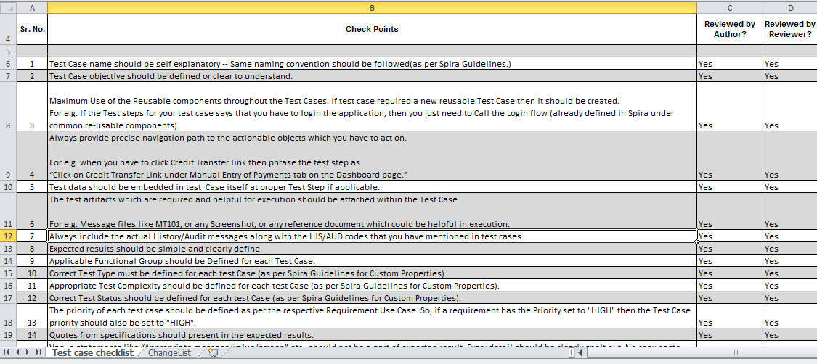
TC Drafting Checklist
A Standard set of Test Case Drafting Checklist has been framed to be followed across Projects/Products in C2P

Slide 5
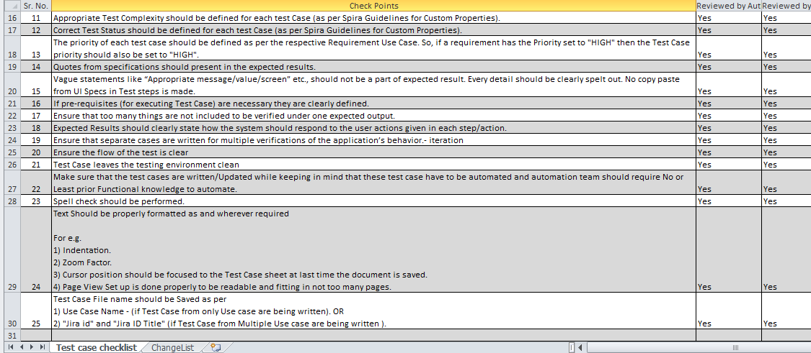
TC Drafting Checklist
A Standard set of Test Case Drafting Checklist has been framed to be followed across Projects/Products in C2P

Slide 6
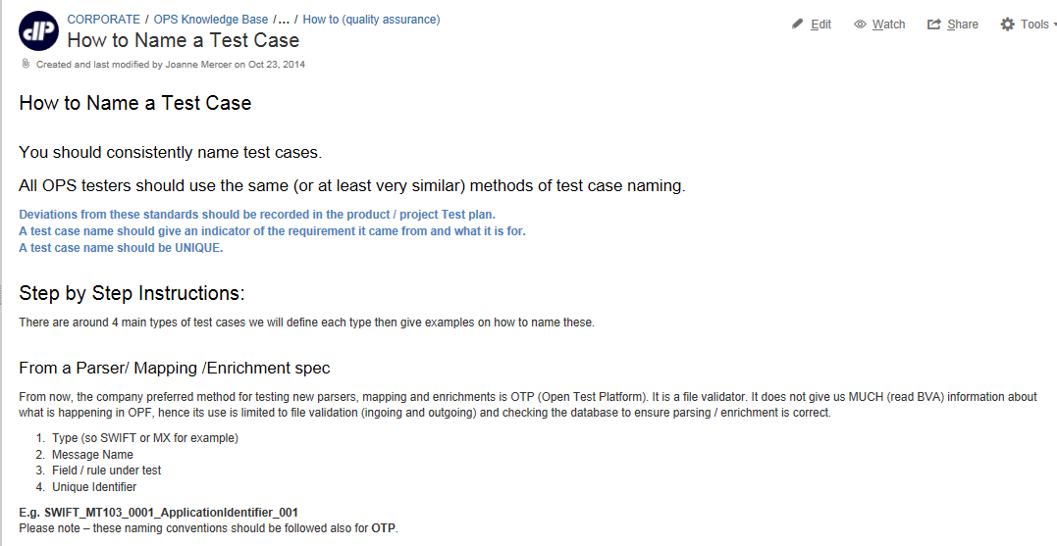
How to Name a TC
Following snapshot gives reference on How to Name a TC

Slide 7
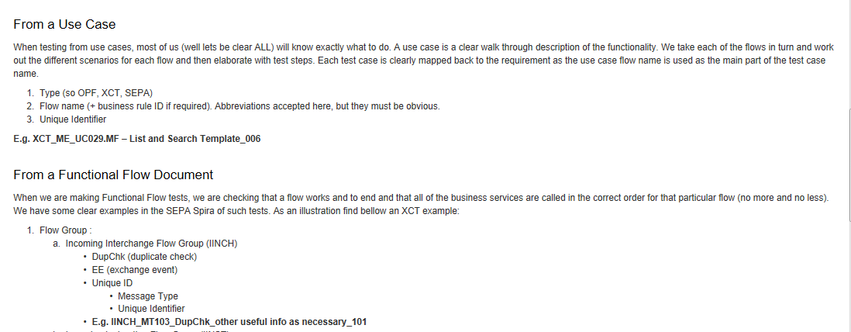
How to Name a TC
Following snapshot gives reference to How to Name a TC

Slide 8
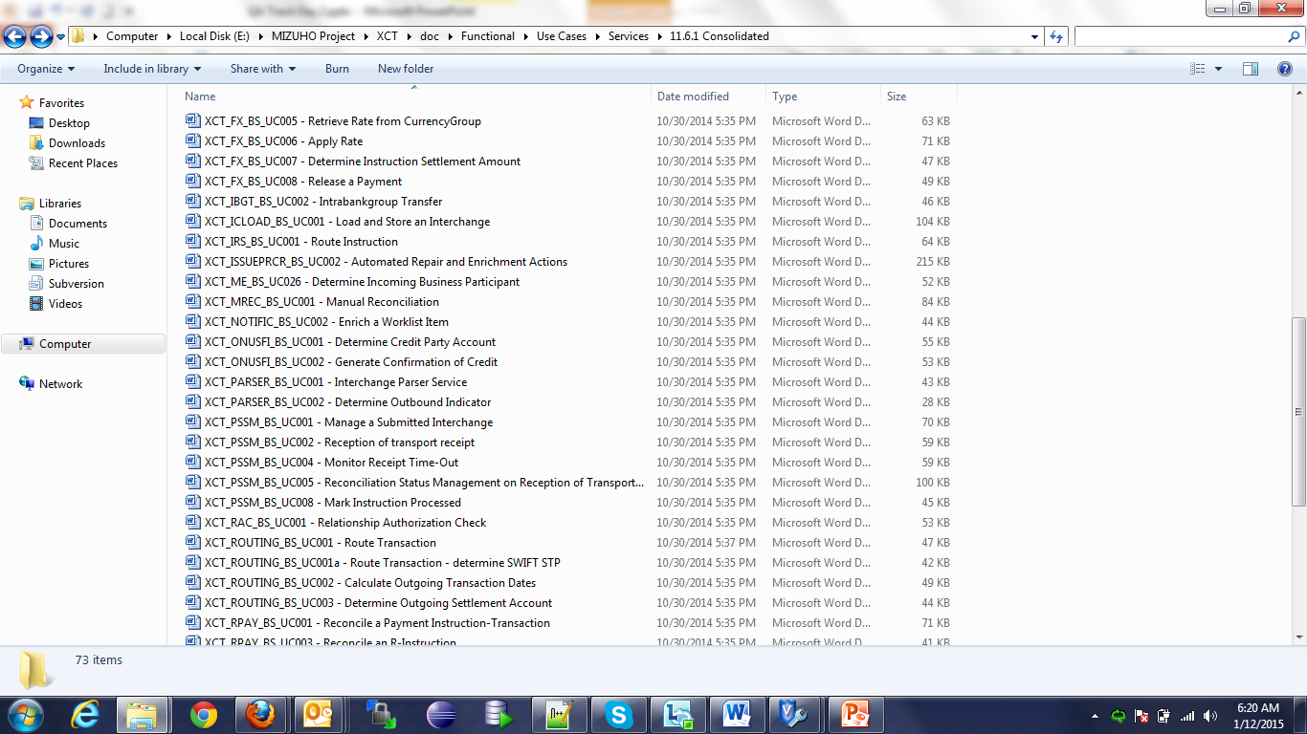
Reading and understanding Requirements
This section covers on how to understand the XCT Use Case which has reference to OPF/SEPA Use Case and any other Requirement documents
Open the Use Case from the following XCT SVN Location: https://svn-mec.clear2pay.com/svn/repos/rd/core/XCT/trunk/doc/Functional/Use Cases/Services/11.6.1 Consolidated/XCT_PARSER_BS_UC001 - Interchange Parser Service

Slide 9
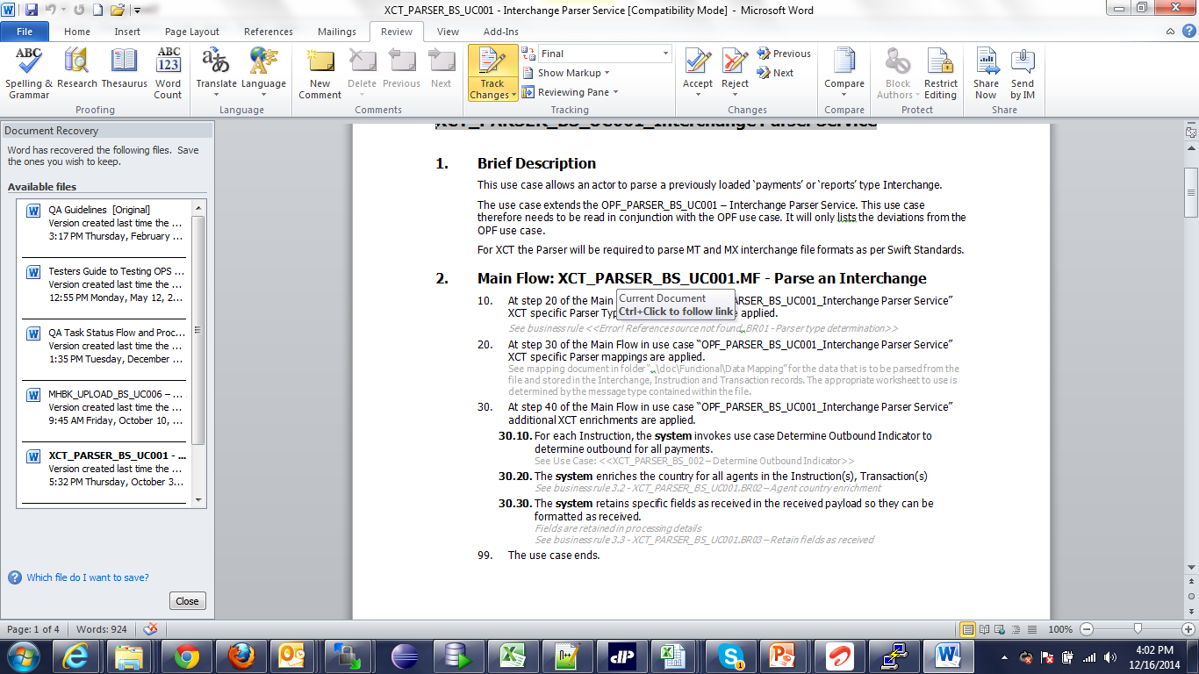
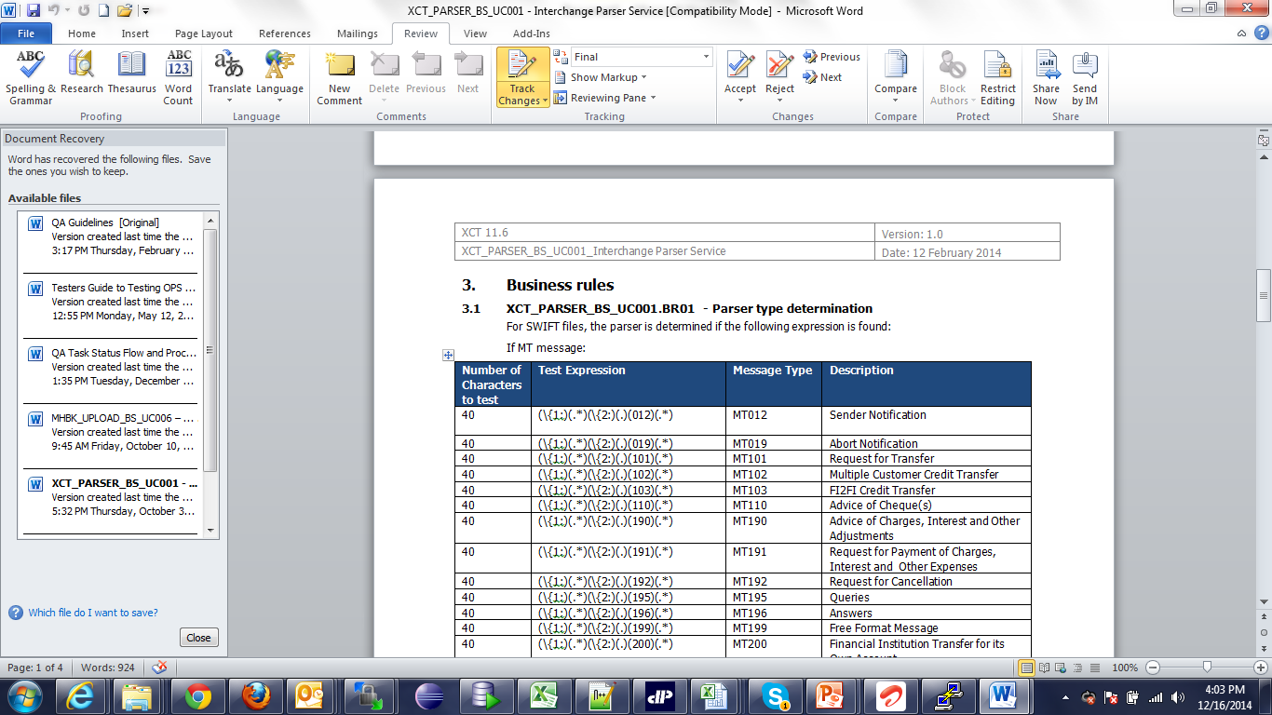
Reading and understanding Requirements
Use Case will have Brief Description, Main Flow, Alternate Flows, Exception flows, Extension Points, Business Rules, Revision History etc. This particular Use Case however has few sections only.

Slide 10
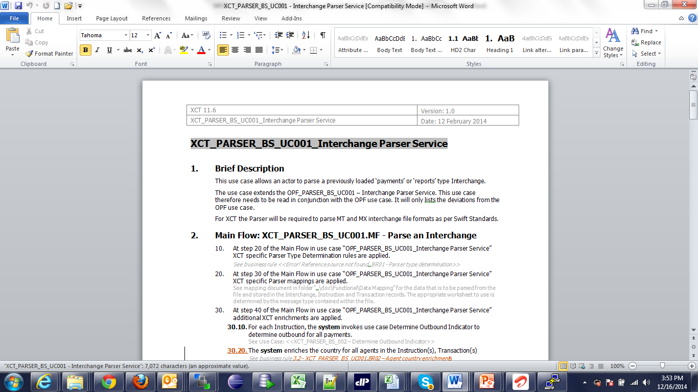
Reading and understanding Requirements
The Use Cases are designed in such a way that they are re-usable and refer to only customization on top of OPF/SEPA Layer.
In many Use case, one can find that Brief Description may often refer to OPF/SEPA Use Case. Lets go through this Use Case.
In the brief Description, Use refers to “OPF_PARSER_BS_UC001 – Interchange Parser Service”

Slide 11
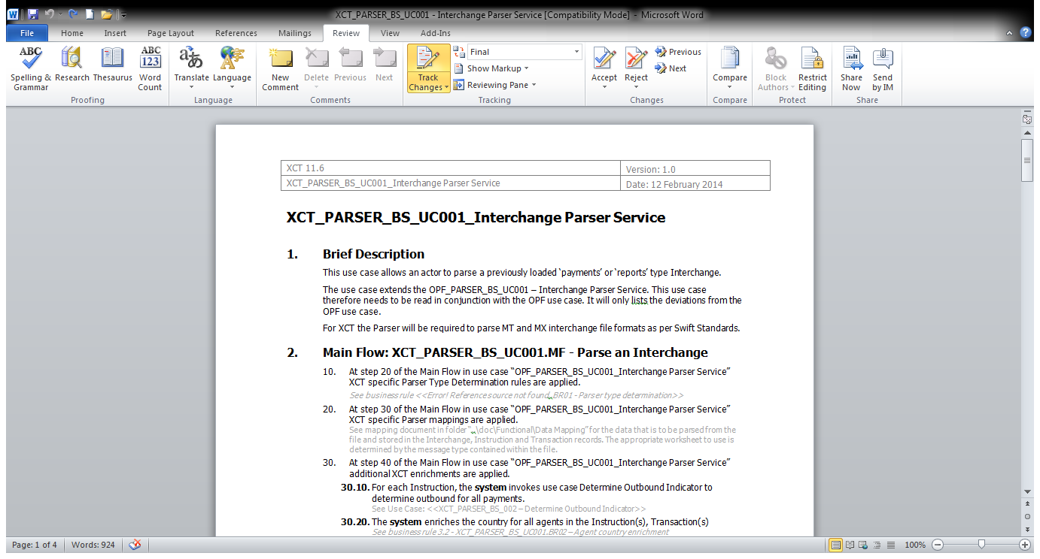
Reading and understanding Requirements
In the Main flow, we can notice that it refers to Mapping document and mapping document needs to be opened and covered as part of testing:
Mapping documents needs to be referred according to file type to be used.

Slide 12
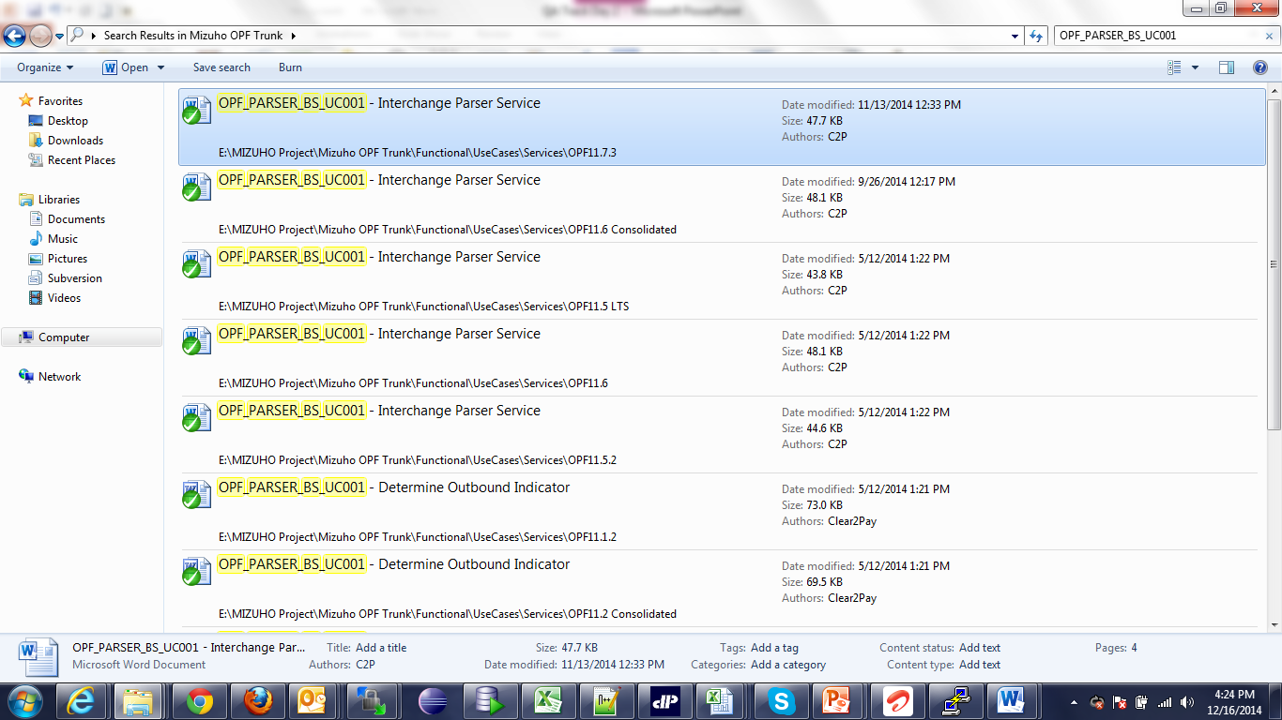
Reading and understanding Requirements
In order to understand this Use case, we need to go through the OPF Use Case. Navigate to following path:
https://svn-mec.clear2pay.com/svn/repos/rd/core/OPF/trunk
and search for OPF_PARSER_BS_UC001 – Interchange Parser Service

Slide 13
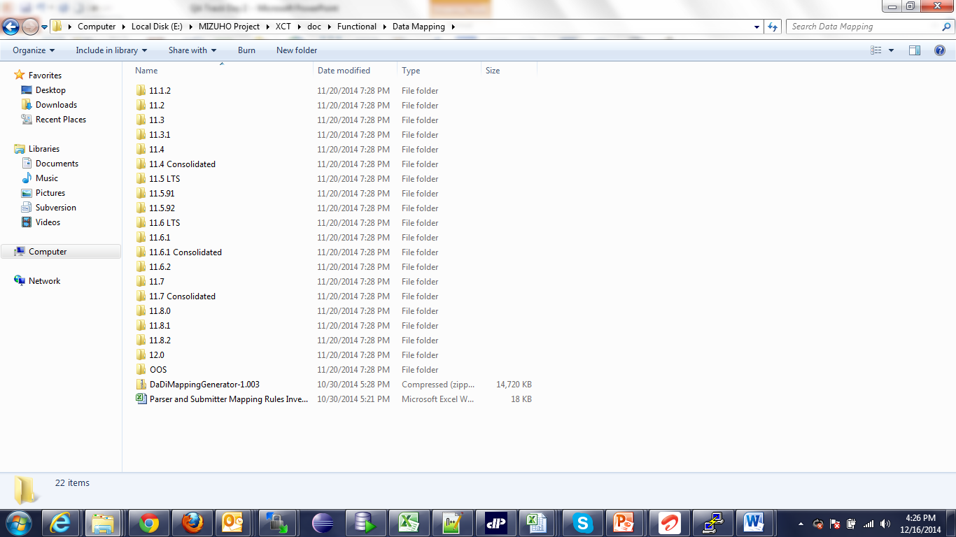
Reading and understanding Requirements
According to the OPF Version installation in Project, open the relevant Use Case and go through the whole Use Case.
Any other reference of Use Case, if given in the OPF Use Case has to be searched though the same mechanism.
For Data Mapping of file formats, navigate to the following path and open the relevant sheet:
https://svn-mec.clear2pay.com/svn/repos/rd/core/OPF/trunk/doc/Functional/Data Mapping/11.7 Consolidated

Slide 14
Reading and understanding Requirements
10. Test Scenario need to be designed based on Main flow, Alternate flow etc. and covering all the aspects of the Use Case. One may also need to cover the functionality from OPF Use case.
11. After analysis of the requirements, in case of any queries, QA can write down the queries in Query log /JIRA and BA can respond to those queries accordingly.

Slide 15

Question & Answers

Slide 16
EMEA – Headquarters
Brussels, Belgium
info@clear2pay.com
APAC
Sydney, Australia
info.apac@clear2pay.com
Americas
Atlanta, USA
info.americas@clear2pay.com
www.clear2pay.com

